Slide 1
Coding with Alexa
Garrett Vargas
CTO and VP of Technology, CarRentals.com

Slide 2
Course Prerequisites
Assumed Development Knowledge
You do NOT need any language-specific or cloud-specific knowledge (we will be writing an AWS Lambda function in node.js but not using advanced concepts)
You are expected to understand basic programming concepts like variables, functions, and objects
Sign up for a free AWS developer account
AWS Management Console: https://aws.amazon.com/console
Amazon Developer Portal: https://developer.amazon.com
You need to provide a credit card, but 1 million Lambda requests per month free ($0.20 per million after that); more than enough for development
Sign up for a free account at Dashbot (www.dashbot.io)

Slide 3
Inside an Alexa Request
“Alexa, tell the class what we will learn today”
Specific request, question, or command
Invocation name that identifies a skill
Wake word to start the conversation
Keyword to request a service

Slide 4
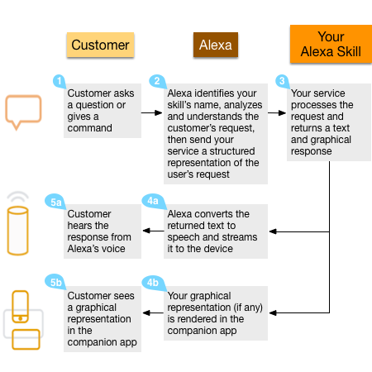
Inside an Alexa Request
“Alexa, tell the class what we will learn today”

Slide 5

Lambda Functions
Run code without managing servers – you write code that responds to triggers
Used for tasks like processing file uploads (transforming flat files to structured content) and stream processing
Alexa can be a trigger that launches your code after a customer speaks your invocation name
No need to create a service
No need to process natural language speech
Your function takes a JSON object as input and returns a JSON object defined by Alexa

Slide 6
Hello World

Slide 7
Intent Slots
Provides a way to pass parameters in with your intents
Can use one of the pre-defined slot types defined at https://developer.amazon.com/public/solutions/alexa/alexa-skills-kit/docs/built-in-intent-ref/slot-type-reference
Or can create a Custom Slot Type, in which case you provide an enumerated list of possible values (we will not be covering this in this workshop)
Let’s add to Hello World to optionally take in the name of a person, and use that person’s name in our response

Slide 8
Session Attributes
Provides a way to preserve data between calls when the session stays open
Set alexaResponse.sessionAttributes to custom-defined attributes
Attributes are passed in event object (event.session.attributes)
Make sure alexaResponse.response.shouldEndSession is false
Let’s add to Hello World to ask a question and then remember the person’s name when responding to the answer

Slide 9
Sound and SSML
Speech Synthesis Markup Language - https://developer.amazon.com/docs/custom-skills/speech-synthesis-markup-language-ssml-reference.html
Can provide emphasis, pauses, effects, and more!
Can play custom audio files with audio tag
Built in library from Amazon (https://developer.amazon.com/docs/custom-skills/ask-soundlibrary.html)
Custom files must use MPEG2 codec and 48 kbps bit rate
Audacity (http://www.audacityteam.org/) is a free tool that can convert sound files

Slide 10
Alexa SDK
NPM module that simplifies skill development - https://www.npmjs.com/package/alexa-sdk
Supports states, persisting attributes to DynamoDB, multi-language support, video directives for Echo Show, and more!
Sample of Hello World from scratch at https://www.npmjs.com/package/alexa-sdk#getting-started-writing-a-hello-world-skill

Slide 11
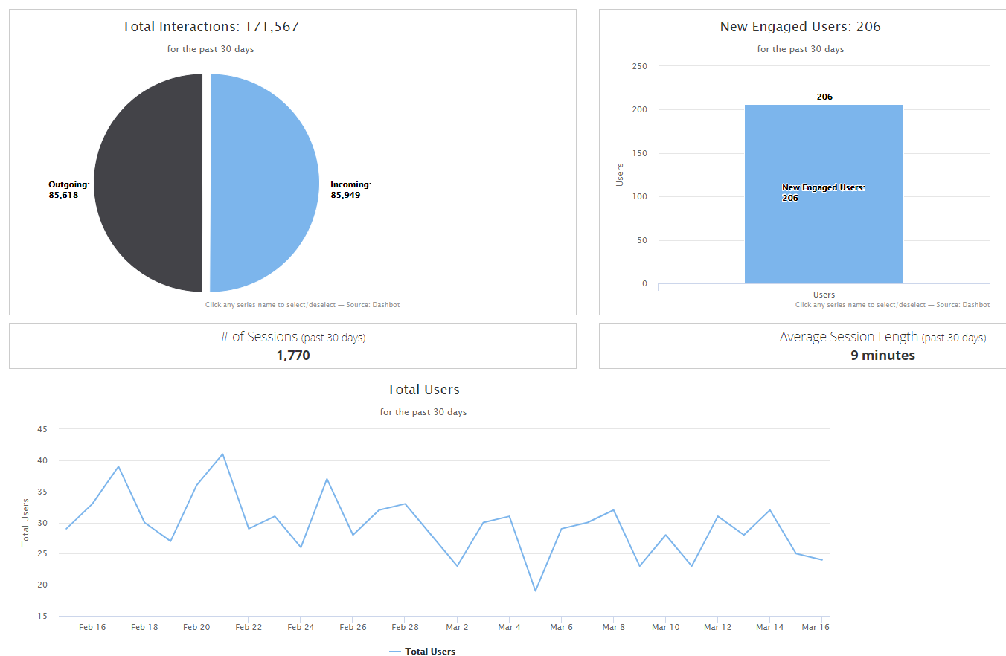
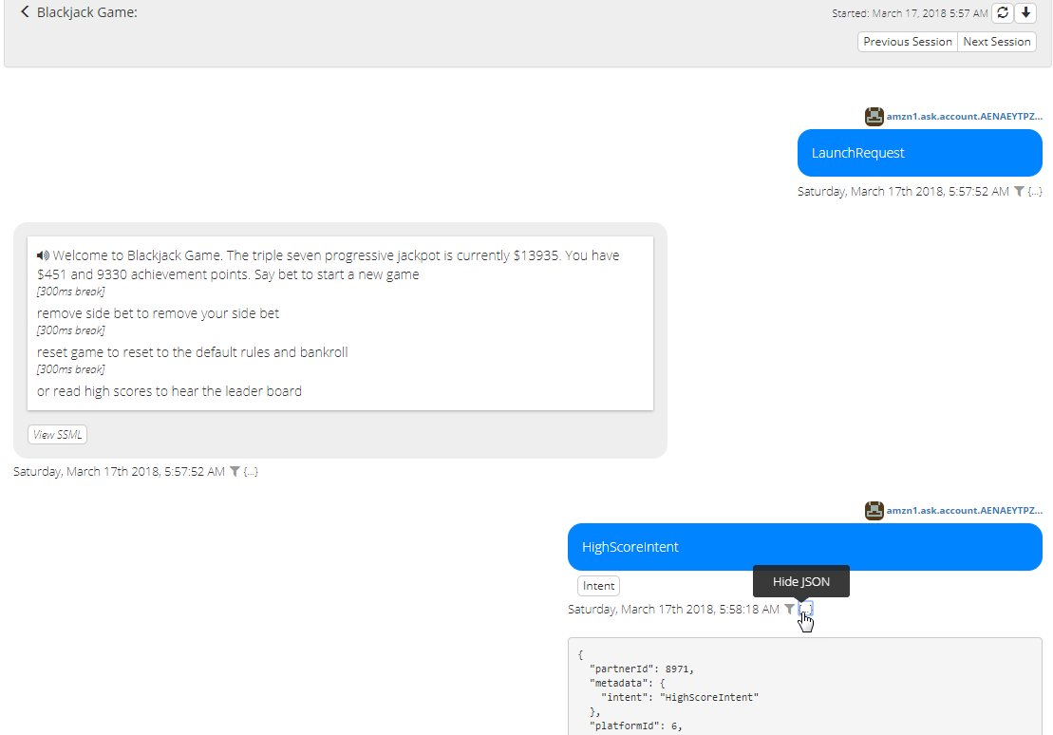
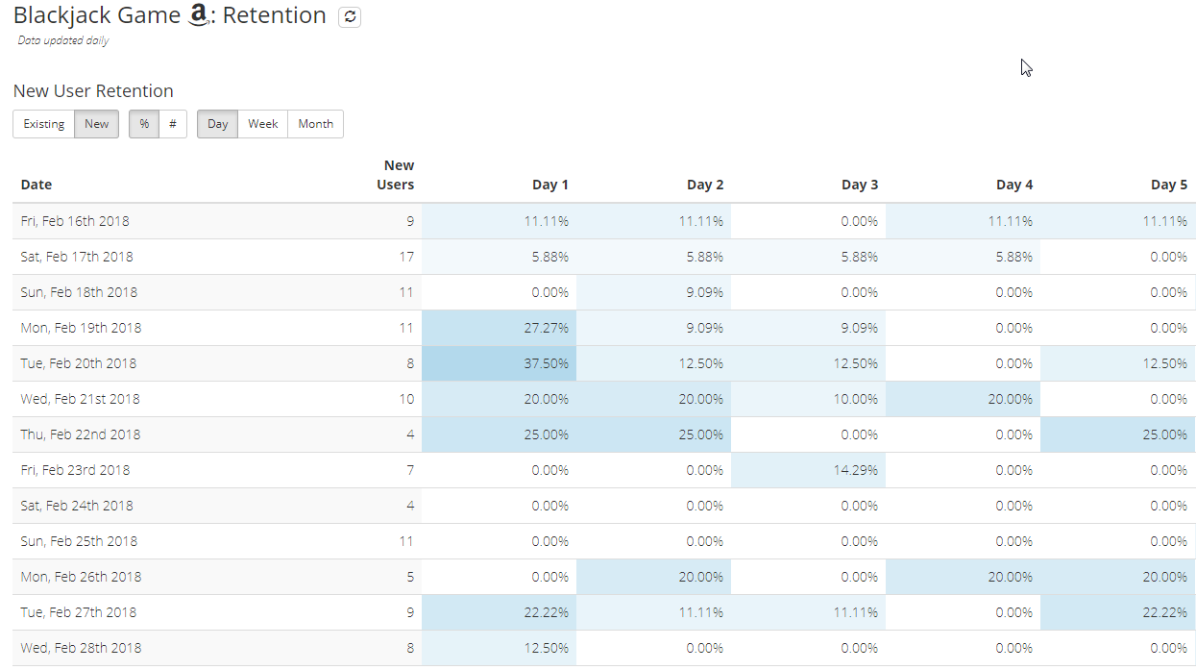
Analytics with Dashbot

Slide 12

Brand Expedia Alexa Skill

Slide 13
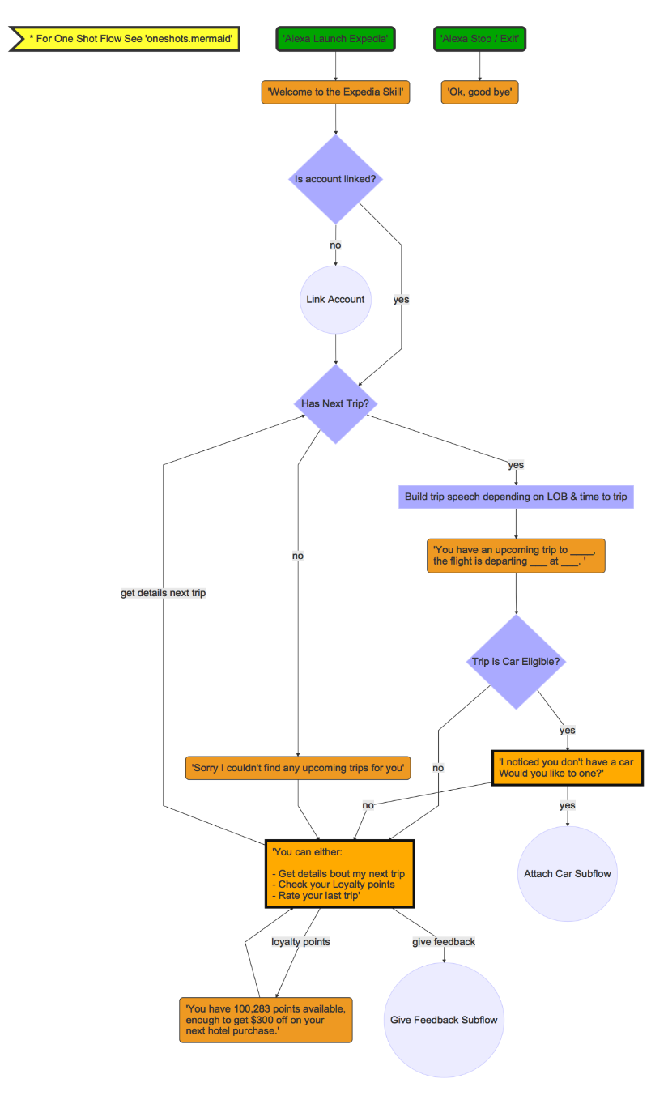
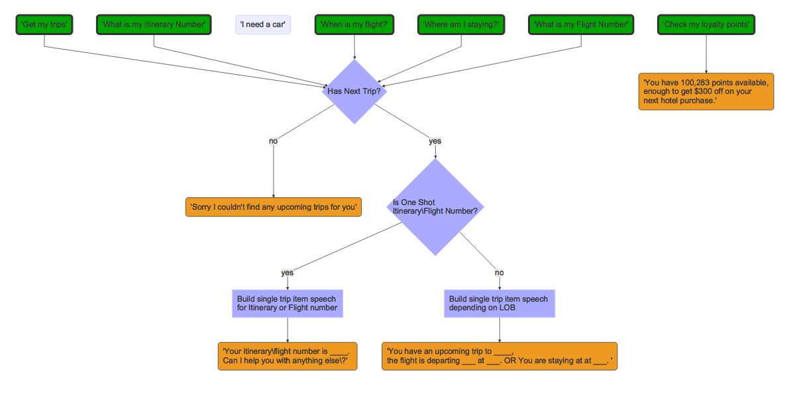
Voice User Interface (VUI)

Slide 14
Resources
Amazon Alexa Skills Kit: https://developer.amazon.com/alexa-skills-kit
Amazon step-by-step guide to building a skill: https://developer.amazon.com/public/solutions/alexa/alexa-skills-kit/content/fact-skill-1
External developer community: amazonalexa.slack.com
Dashbot documentation: https://www.dashbot.io/docs/alexa/lambda
Amazon source code samples
Node.js: https://github.com/amzn/alexa-skills-kit-js
Java: https://github.com/amzn/alexa-skills-kit-java

